Slide 1
Voter’s Assessment
Mentor: Dr. Sunil Pratap
(Assistant Professor)
Submitted by: Ashish Kumar Rout
Roll No.: 00411624417

Slide 2
Content
Company profile
Problem Statement
Objective
Description
Technology used
Data flow diagram
Screenshots
Conclusion
Limitations
Future scope
References

Slide 3
Company profile
Company name: Aam Aadmi Party
Aam Aadmi Party (AAP), is an Indian political party, formally launched on 26 November 2012, and is currently the ruling party of the National Capital Territory of Delhi.
It deals in various profiles like HR, Public Speaking, Data Analytics and Machine Learning.

Slide 4
Problem Statement:
It has been seen that in 2013 Vidhan sabha election that aap and congress was almost toe to toe but suddenly in 2015 vidhan sabha election they won by a large margin and the margin was achieved by the votes acquired previously by congress.
So we wanted to analyze the voters who are most likely to swing and which age category so we did this analysis and also we wanted to find the migrants as well as analyze different families to get better idea what kind of policy they might like.
We find the swingable voters by category using a simple frequentist approach
What we did was first, find the frequencies in different categories of age group through the data we extracted from electoral roll.
Then, we also find the frequencies of different political parties through the data we extracted from form 20 of the same locality and merge the two to find the swingable voters by age group in different political parties.

Slide 5
Objectives:
Find out how many male and female voters are there in the given electoral roll for the polling stations. Also segregate male and female voters separately in intervals of five years.
Obtain form 20 data for five polling stations for the last assembly or Parliament election. Find out the probabilities of different age groups voting for BJP.
segregate voters family wise and find out the name of the head of the family, house number and number of members in that family
which are the voters who are likely to be migrants?
Try to study the EPIC ID which is Voter ID, system. What information can you gather out of it? Given the structure of the EPIC ID, is it possible to find out when a specific person has become a voter in this locality or when was a person’s name included in the electoral roll for this polling station. A range of years would also be okay.

Slide 6
Technology used:
Python 3.7 with various libraries
Libraries:
Numpy
Matplotlib and Seaborn
sklearn
Pdf2Image, Optical Character Recognition (OCR), Python Imaging Library (PIL), OpenCV and Tesseract
Jupyter notebook
Anaconda 2018.12
Excel 2019

Slide 7
Collection of data:
We extracted electoral roll using image processing. Source of this data is election commission’s website.
Collection of features was done through web scraping.
Optical character recognition techniques were used in image processing and geolocation API was used in web scraping.

Slide 8
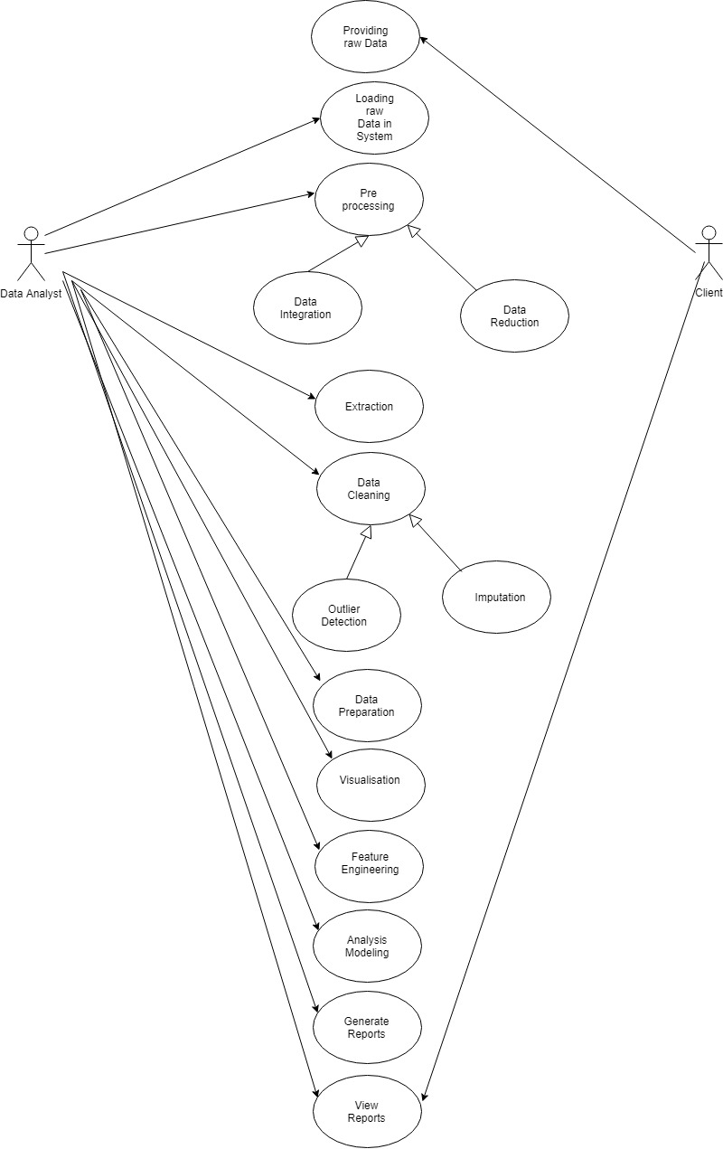
Use Case Diagram

Slide 9
DFD: Level 0
Voters Assessment Model
Client
Raw Data
Voter’s Details
Data Analyst
Reports
Processed voter’s detail

Slide 10
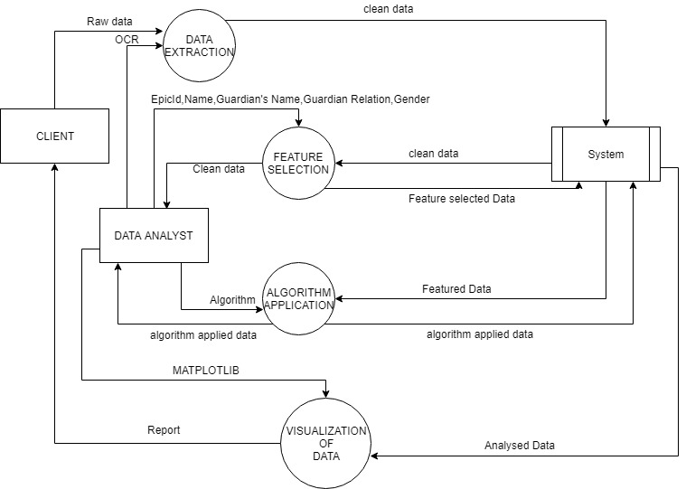
DFD LEVEL 1

Slide 11
Workflow Diagram
START
Raw Electoral Roll Data
Pre-Processing and
Data Cleaning
Visualisation
Frequentist Approach
Feature Selection
END

Slide 12
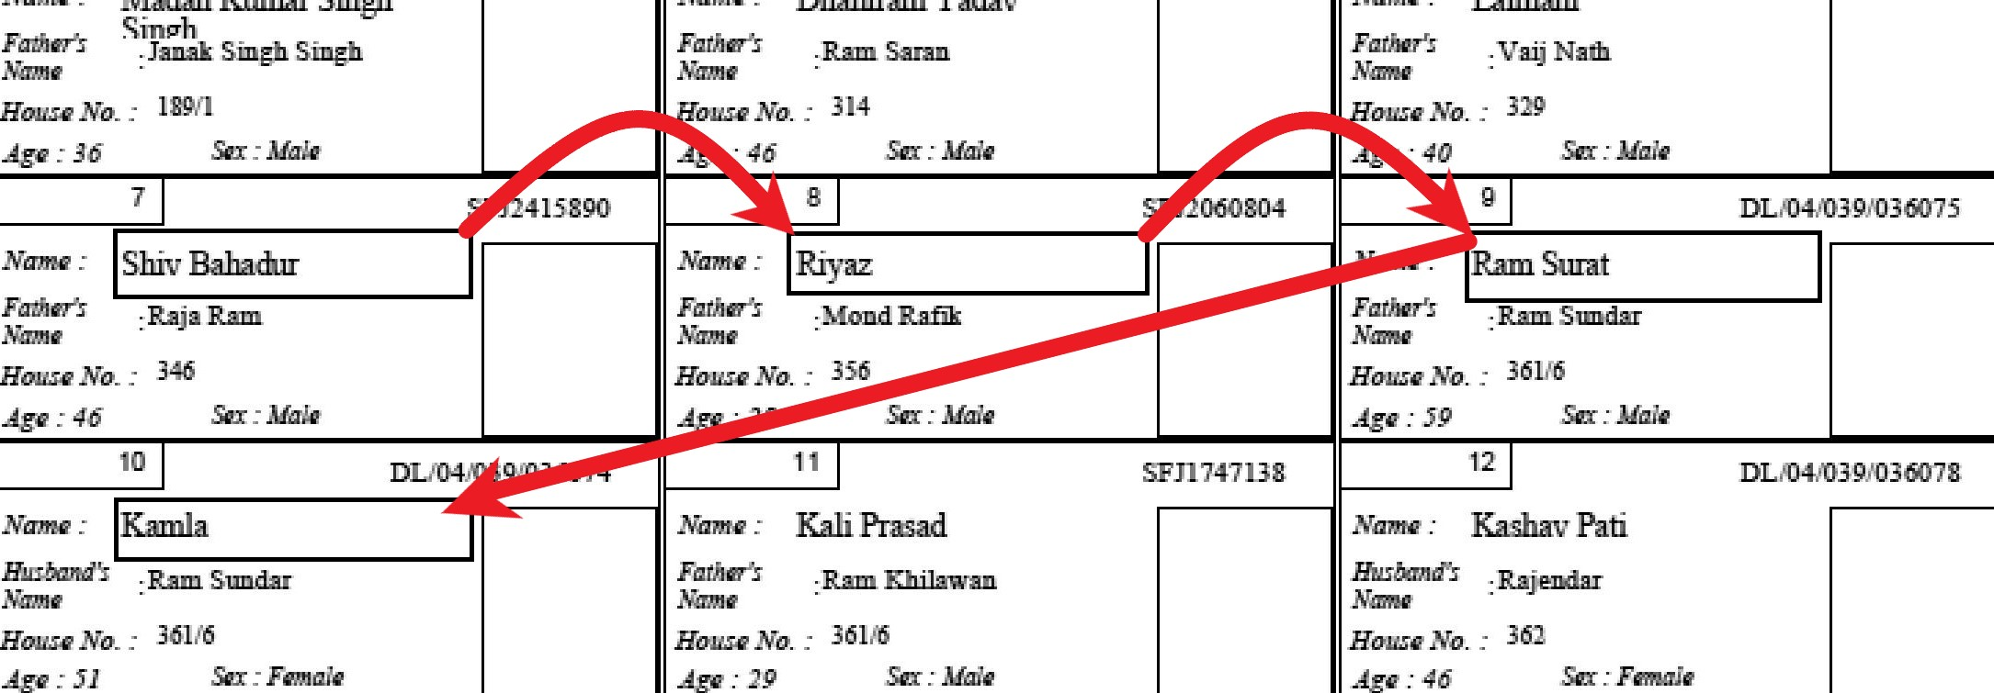
Extraction of Data
We crop part of image rectangularly and extract text of image.
Additionally we have to extract same data 30 times. We know they have equal distance. So will hop one by one till we reach end of the page. We will do that for every feature we are extracting. Notice that in below image that we extend the size of box to max on right, that is because we are not sure what will be the length of name.

Slide 13
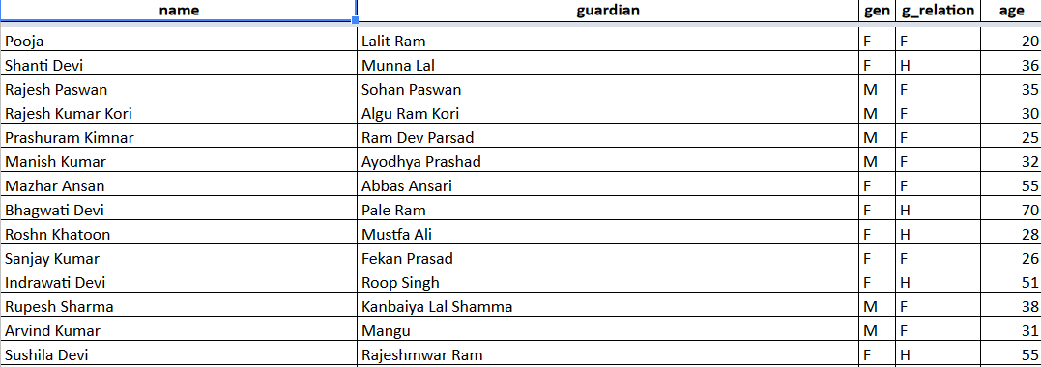
Combining Multiple files
Used combine code to combine 500 files after extracting. We can combine tesseract 3 and 4 files easily using filenames

Slide 14
PROCEDURE OF ANALYSIS
We did use Frequentist approach:
First, we found the age group wise population through electoral data we Extracted.
Then, using form 20 data we find the likelihood of major parties.
After that, we combine the age group wise likelihood and major parties likelihood to come up with likelihood of different age group voting for different parties.
We also found out about the Religion of every person using their surnames.
Finding about which person is likely to be a Migrant.

Slide 15
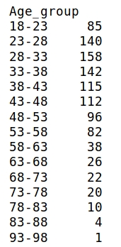
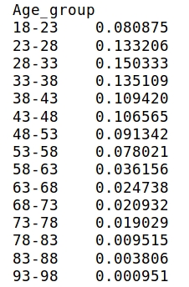

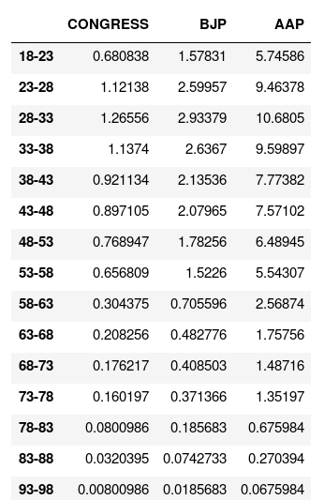

Slide 16
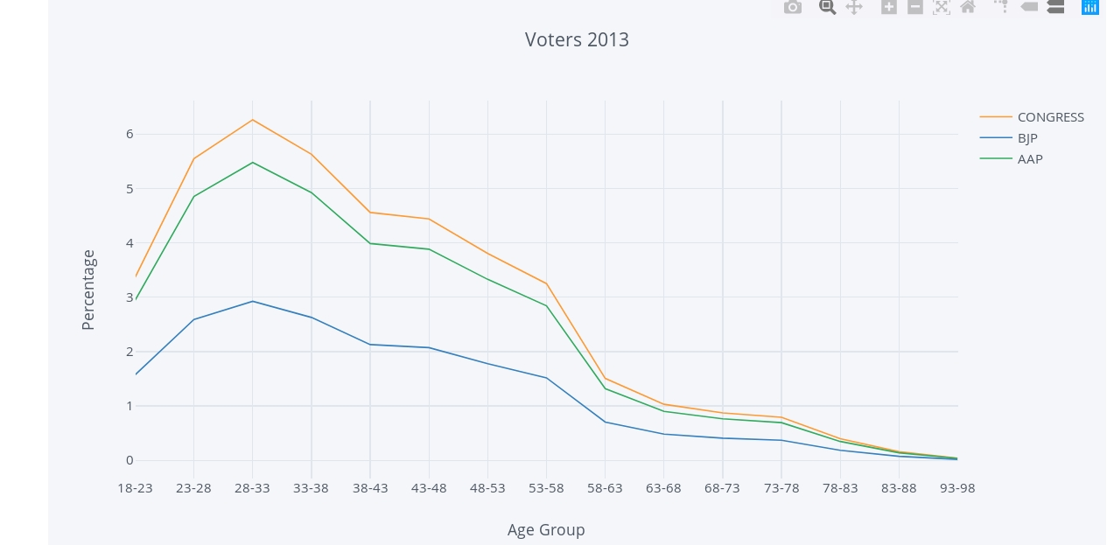
Voter’s trend in 2013

Slide 17
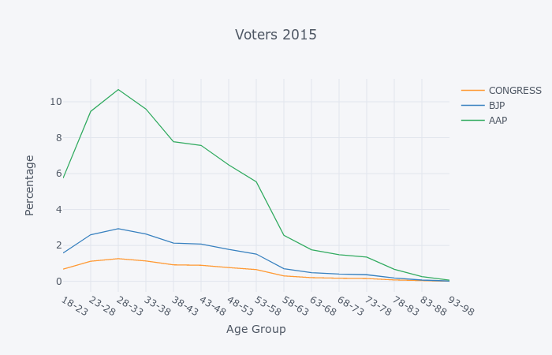
Voter’s trend in 2015

Slide 18
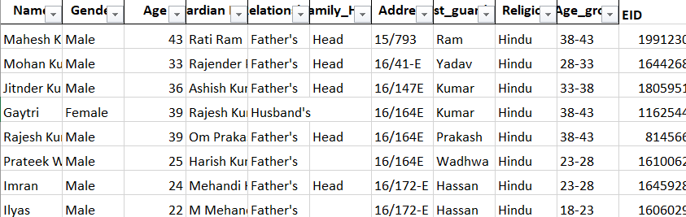
Head of the family

Slide 19
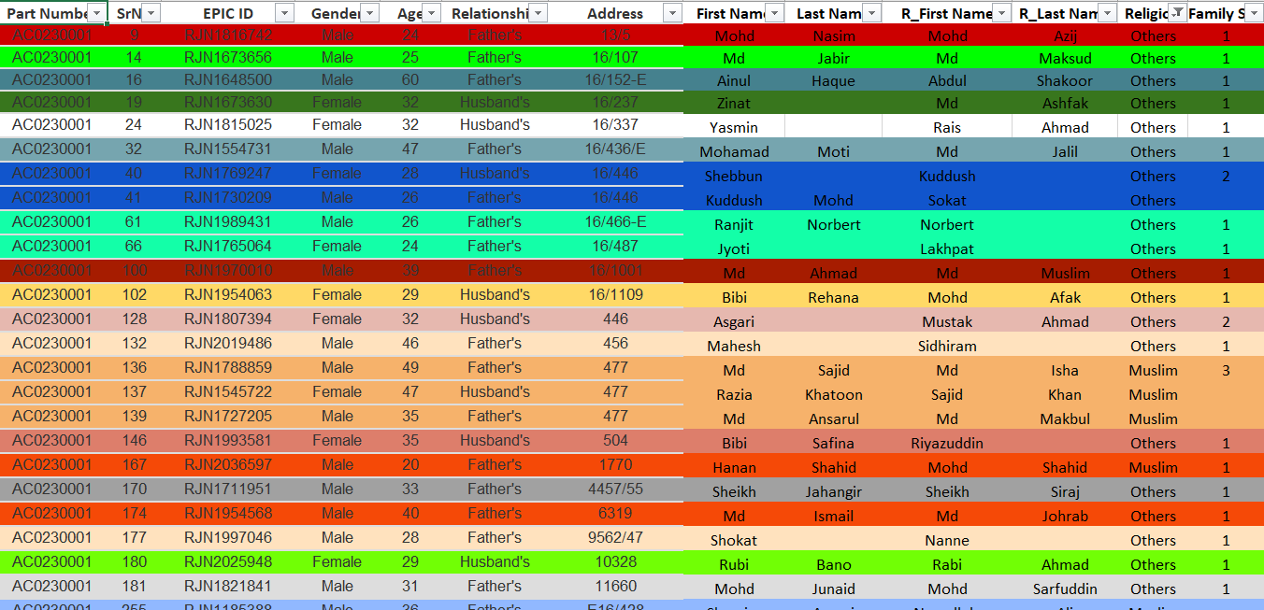
Family Analysis

Slide 20
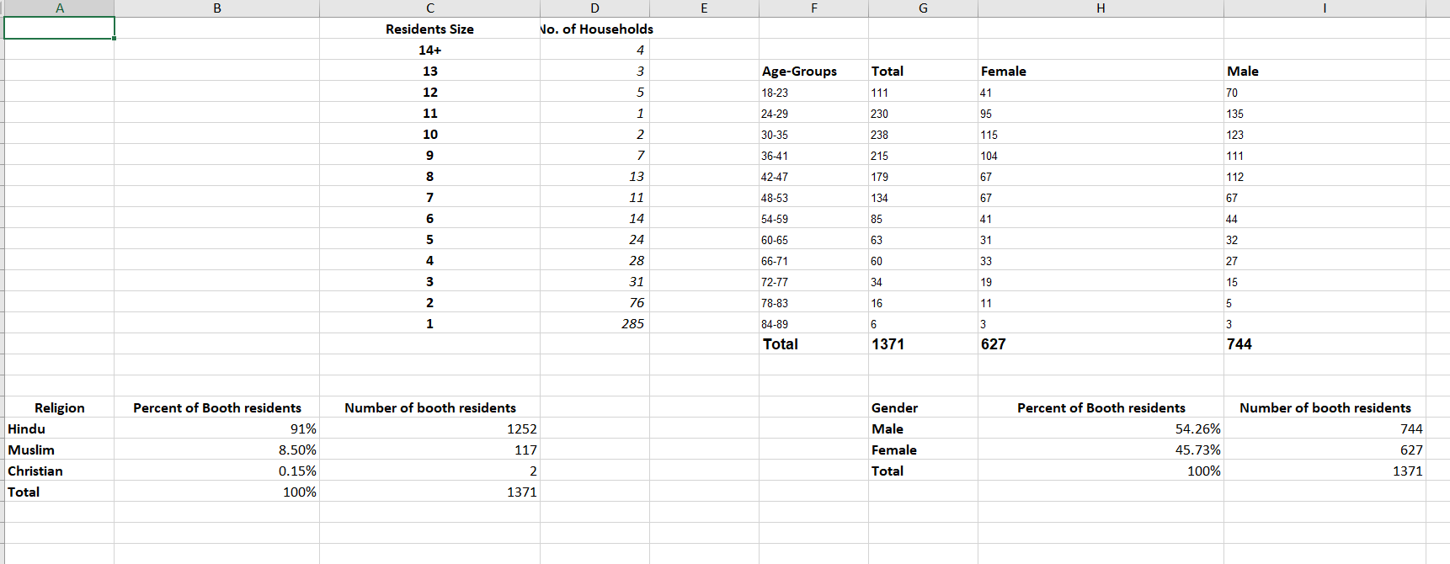
Overall idea

Slide 21
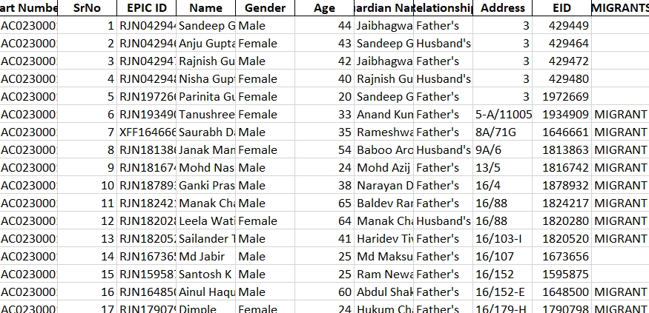
Migrants Analysis

Slide 22
Conclusion
2823 out of 6173 are migrants in part 4 of Karol Bagh.
The most Swingable voters are in the age group 18-23, 23-28, 28-33.
Many peoples living alone so they became head of their own family.

Slide 23
Limitations
The data transfer undergoes encryption methodology that is conventionally complex and costly.
The requirement of high processing systems and upgraded browsers capable of handling trillions of records is another issue.

Slide 24
FUTURE PROSPECTS
We can further extend this project by conducting Frequentist Aprroach, Family analysis(between two or more different constituencies, for eg: R.K. Puram and Rajinder Nagar).
Currently we have only conducted intra-cluster analysis (within one constituency).
We can predict features of other constituencies by determining the similarity of their regions based on the affluence of that region.

Slide 25
References
https://www.tutorialspoint.com/python/
https://www.scrapehero.com/web-scraping-tutorials/
https://www.stackoverflow.com/
https://www.youtube.com/watch?v=mKxFfjNyj3c
Christopher M. Bishop, “Pattern Recognition and Machine Learning”, Springer, 2006
Jiawei Han, Micheline Kamber and Jian Pei, “Data Mining Techniques and Concepts”, Morgan Kaufmann Publishers, 3rd Ed., 2012
Allen B. Downey, “Think Stats: Probability and Statistics for Programmers”, Green Tea Press, 2011

Slide 26
ACKNOWLEDGEMENT
This project has been successfully completed under the mentorship of:
Mr. Akhilesh Ajith Kumar
Mr. Suyash Gulati

